Slide 1
RatticDB
Elizabeta Sørensen @zemmiph0bia

Slide 2
What?!
Open Source
Django <3
Simple to use
Able to manage humans
- Departing team members
- LDAP / Active Directory
Audit logs for accountability
Simple API
Import from KeePass 1.x

Slide 3
Why?!
Several types:
Filesystem
Network
Post-it Note
Trouble handling larger teams
UI’s are often a disaster
Hard to audit
Difficult to manage team changes
Managing ACL’s can be a pain point
May only work on Windows / OSX

Slide 4
How?!
Encryption is done on the filesystem
We rely on HTTPS being setup
Works on databases supported by Django
Passwords are in a single group
Tagging for organization
Change queue for your pleasure
Users can be a member of many groups
LDAP / AD integration

Slide 5
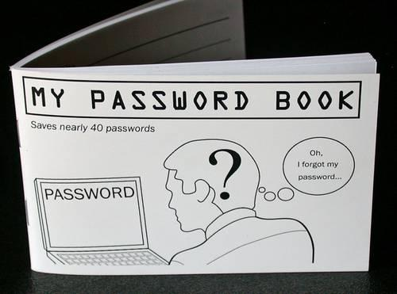
https://demo.rattic.org/ U: admin P: rattic

Slide 6
Rattic needs you!
Use it
Break it
Help us build it
Tell us what you think
http://rattic.org/

